Slide 1

CSE211 - Formal Languages and Automata Theory
U1L1 - Introduction to FLAT
Dr. P. Saravanan
School of Computing
SASTRA Deemed University

Slide 2
Agenda
General instructions
What is Automata?
What is Formal Language?
Alphabet
String
Language
Chomsky hierarchy

Slide 3
Think about you
Be proud about you
Have positive attitude
Be Aligned and focused
Learning is students centered
Self discipline and be motivated

Slide 4
Your role
Active participation
Regularly attending the class
Listening the professors’ talk
Taking notes on your own
Referring other resources
Collaborative learning

Slide 5
Add value to your Resume
Focusing on CGPA
Participating the association and Club activities
Reading e-resources
Preparing Aptitude
Preparing Technical (c, c++, java and python)
SWAYAM or online courses
Certificate courses
Trying mini projects

Slide 6
What is Automata Theory?
It is the study of abstract computational devices
Abstract devices are (simplified) models of real computations
Computations happen everywhere
Switch on the computer,
pressing key,
selecting an app or program,
typing a character…
Why do we need abstract models?

Slide 7
Why Abstract Model?
Any Computer or devices can be designed infinite number of ways
It is difficult to reason about each design
Abstract model can be a representation of a computer or device design
Each abstract model is referred as automata
Useful to model many kinds of hardware and software
Ex: Finite Automata, Push Down Automata, Turing machines etc..

Slide 8
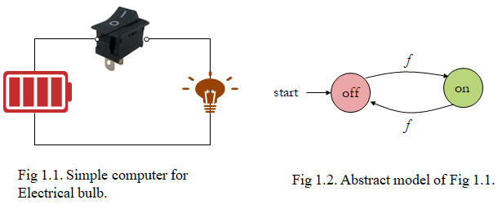
Abstract Model: ‘Computer’
input: Current
output: Light bulb
actions: Flip switch
states: On, Off
Bulb is on iff there was an odd number of flips

Slide 9
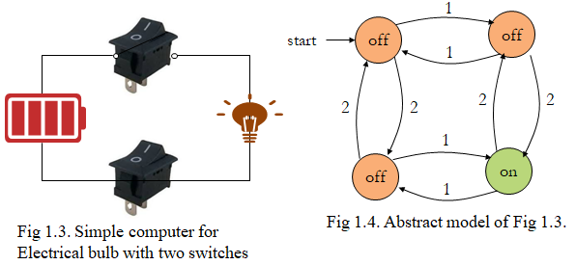
Abstract Model 2: ‘Computer’
input: Current
output: Light bulb
actions: Flip switches
states: On, Off
Bulb is on iff both switches were flipped odd number of times

Slide 10
Why FLAT? : Compiler

Slide 11
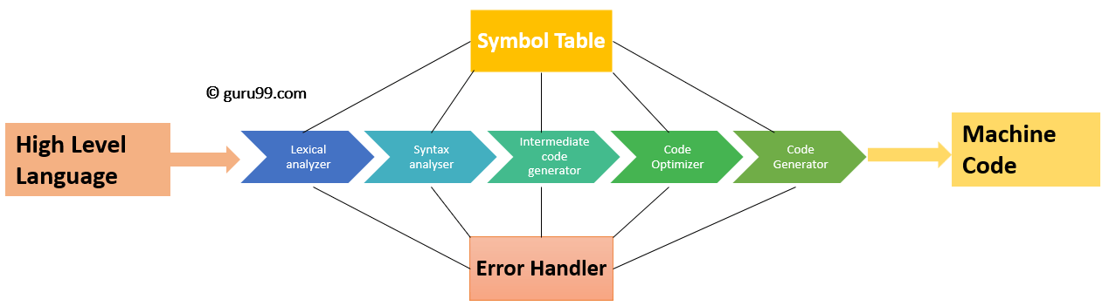
Compiler Phases

Slide 12
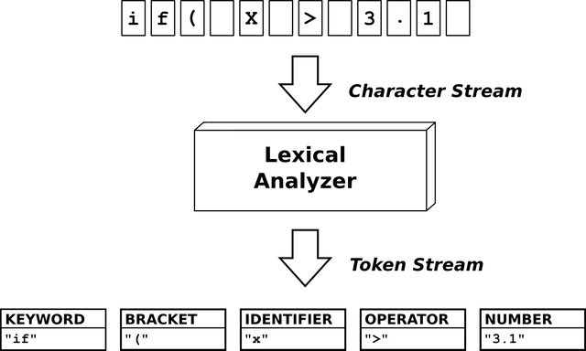
How Scanner works?

Slide 13

Scanner uses Finite Automata!!!
They are the finite collections of states with transition rules that take you from one state to another.
Original application was sequential switching circuits, where the “state” was the settings of internal bits.
Today, several kinds of software can be modeled by FA.
Ex:
Fig. A finite automaton modeling recognition of then

Slide 14
Importance of the Course
The course forms the basis for:
Writing efficient algorithms that run in computing devices
Programming language research and their development
Efficient compiler design and construction
Focusing on
Automata Theory
Computability Theory
Complexity Theory

Slide 15
Unit 1
Introduction: Alphabet, languages and grammars, productions and derivation, Chomsky hierarchy of languages
Regular languages and finite automata: Deterministic Finite Automata (DFA) - Nondeterministic Finite Automata (NFA) – Finite Automata with Epsilon Transitions – Regular Expressions - Finite Automata and Regular Expressions - Kleene’s theorem- Regular grammars and Equivalence with Finite Automata - Properties of Regular Languages: Proving Languages Not to Be Regular–Closure Properties of Regular Languages - Myhill-Nerode theorem -Minimization of Finite Automata

Slide 16
Unit II
Context-free languages and pushdown automata: Context-free grammars (CFG) – Parse Trees - Ambiguity in Grammars and Languages - nondeterministic pushdown automata (PDA) - Equivalence of PDAs and CFGs - Deterministic Pushdown Automata - Properties of Context Free Languages: Normal Forms for Context Free Grammars - Chomsky and Greibach normal forms - Pumping lemma for context-free languages - closure properties of CFLs

Slide 17
Unit III
Context-sensitive languages: Context-sensitive grammars (CSG) and languages - linear bounded automata and equivalence with CSG
Introduction to Turing machines: The Turing Machine (TM) - Church-Turing thesis Programming Techniques for Turing Machines – extensions to the Basic Turing Machine – Restricted Turing Machine - Turing recognizable (recursively enumerable) and Turing-decidable (recursive) languages and their closure properties, variants of Turing machines, nondeterministic TMs and equivalence with deterministic TMs, unrestricted grammars and equivalence with Turing machines, TMs as enumerators

Slide 18
Unit IV
Undecidability: A Language That Is Not Recursively Enumerable (RE)- Diagonalization languages - An Undecidable Problem that Is RE - Universal Turing machine - undecidable problems about Turing Machines - Reductions between languages and Rice s theorem
Basic Introduction to Complexity: Intractable Problems - Introductory ideas on Time complexity of deterministic and nondeterministic Turing machines – Classed P and NP, An NP- complete Problem - Cook’s Theorem - Additional NP -Complete problems

Slide 19
Text books
John E. Hopcroft, Rajeev Motwani and Jeffrey D. Ullman, Introduction to Automata Theory, Languages, and Computation, Pearson, 3rd Edition, 2011.
Peter Linz, An Introduction to Formal Languages and Automata, Jones and Bartle Learning International, United Kingdom, 6th Edition, 2016.

Slide 20
Summary
About online Semester
Why automata?

Slide 21
Thank you.
Next Class:
Basics of Formal Language

